Slide 1
COSMOS
powered by Tendermint
Join at https://www.sli.do/ using #COSMOS
Notes:
Explain my intention for this talk
Today I want you to understand the fundamental concept of COSMOS and why it is the next evolution of the blockchain industry
Split into three parts: Demo, High Level, Technical Aspects

Slide 2

Who am I?
Adrian Brink
Background Computer Science and Business Management
Lived and worked in Denmark, Canada, Germany, and the UK
Avid drone enthusiast
Research interest:
Consensus Engines
Secure peg zones
Decentralised Exchanges
E-voting
Usability
Notes:
- Quick introduction about myself to get the audience warmed up
I should present myself as Tendermint/COSMOS
Mention that I am working on Ethermint and the Consensus Engine
Explain my interests:
E-voting: How can large or distributed companies make decisions without the need for physical votes

Slide 3










Who’s behind COSMOS?
The core team of 10 (and growing) amazing people
Notes:
- I would like to introduce you to the rest of the team
- Make the company more human

Slide 4
Demo Time
Notes:
Demo the counter app
Explain the simple logic that we are building

Slide 5
Questions
Join at https://www.sli.do/ using #COSMOS
Notes:
Please take 3 minutes to write down any questions you might have about the COSMOS hub so that I can answer them later or submit them to sli.do

Slide 6
Why COSMOS?
Scalability
&
Interoperability
Notes:
Why are we building COSMOS and what problems are we trying to solve?
COSMOS solves the interoperability problem that current blockchains face
- Instead of one blockchain to rule them all we can have multiple blockchains communicating with each other
It is highly scalable horizontally and can support 100,000s transcation per second
- When we need more throughput we can simply add more zones to the COSMOS hub in order to increase the number of transactions
It provides the protocol infrastructure for anyone in the world to build their own COSMOS application that can interoperate with the entire ecosystem
Give the analogy of servers and the Internet:
- In the beginning we had separate networks, but eventually we developed TCP/IP. COSMOS is the missing piece, it provides the TCP/IP layer

Slide 7
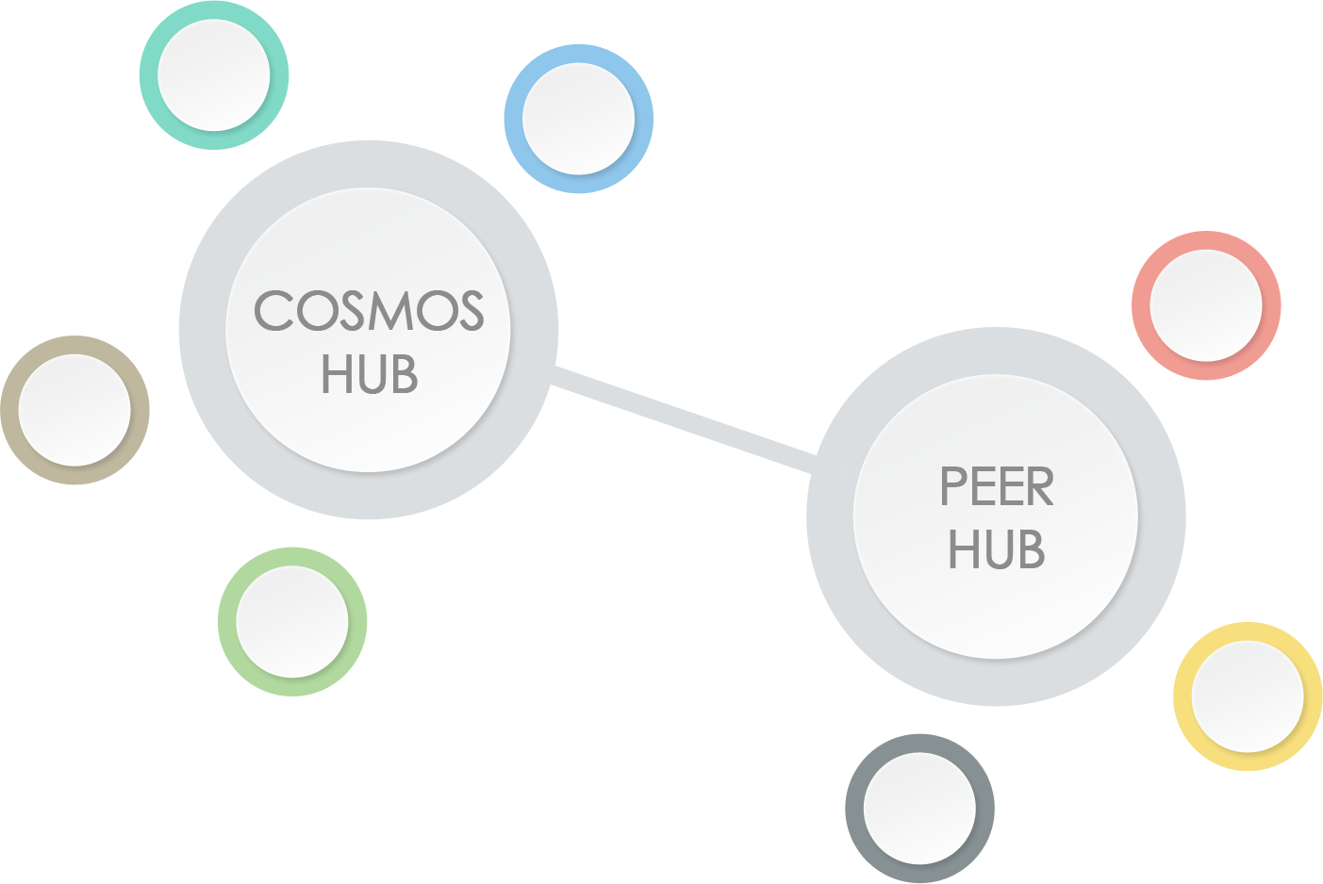
The Theory
Value transfer between zones and hubs
Zone have independent state updates
Hubs are secure connectors
Notes:
This slides explains how COSMOS works
The COSMOS hub will provide an interoperability layer between different blockchains
Zones such as Ethermint can register with the hub and then move value to the hub and potentially to other zones
Interoperability between blockchains
Example: Once we have a second zone for bitcoin you can seemlessly exchange bitcoins for ethereum on the Cosmos hub
Example: AirBnb tokens

Slide 8
The Building Blocks
Tendermint Consensus Engine
Cosmos Hub
Ethermint
Ethereum Peg Zone
Weave
SDK
Notes:
Tie the different products together
What products are we building?
Tendermint Consensus Engine
COSMOS hub
Ethermint
Ethereum Peg Zone
Announce the Weave SDK

Slide 9
COSMOS Apps
Everyone in the world can build their
own zone with their own business logic and
connect it to the COSMOS hub.
Notes:
Explain why developers would choose to build on top of the COSMOS hub
Interoperability with the general ecosystem
Access to the entire userbase
Explain that developers can build their own applications on top of COSMOS and connect them to the entire ecosystem
They can use the Weave SDK or build directly on top of tendermint using the Tendermint Socket Protocol
Explain that private companies can have fully private COSMOS Apps that can still connect to the COSMOS hub
Really stress that point here

Slide 10
COSMOS Hub
Notes:
I have now explained to you the building blocks of the COSMOS hub and I hope that you are as excited as me
I hope that this gives you an insight into what the COSMOS hub will be and how you can benefit from it

Slide 11
Questions
Join at https://www.sli.do/ using #COSMOS
Notes:
Please take 3 minutes to write down any questions you might have about the COSMOS hub so that I can answer them later or submit them to sli.do

Slide 12
Let’s get Technical
Notes:
Now we will start the technical part

Slide 13
Basics
Tendermint Consensus Engine
Proof-of-Stake consensus algorithm
Guarantees safety & liveness
Optimally Byzantine Fault Tolerant
Fully fork accountable
Simplest PoS implementation
Notes:
Consensus algorithm only enforces global ordering of transactions
Unless you have >1/3 you can’t violate safety & liveness
We can pinpoint who cheated and punish them
All other consensus engines are much more complicated and have doubtful sequrity

Slide 14
Basics
Practical Byzantine Fault Tolerant
Notes:
Give the example of the generals
We can have a malicious actor (up to 1/3) and still be safe

Slide 15
Basics
Why Tendermint Proof-of-Stake?
Uses security deposits instead of wasting electricity
Secure and formally verified
Full specification on GitHub
Notes:
Compare this to Bitcoin or ethereum
The only one with a full protocol spec on github
Currently using the same testing techniques that distributed databases use to test our implementation

Slide 16
Basics
Security through Staking
Atoms are mining equipment
Validators instead of Miners
Notes:
Atoms are a tool to be able to secure the network
Compare atoms to GPUs
Explain the concept of validators and non-validators

Slide 17
Basics
Efficient light clients
Notes:
Efficient light clients are possible
Light clients only have to come online every 30 days
Any block they see, they can decide whether it is a valid block

Slide 18
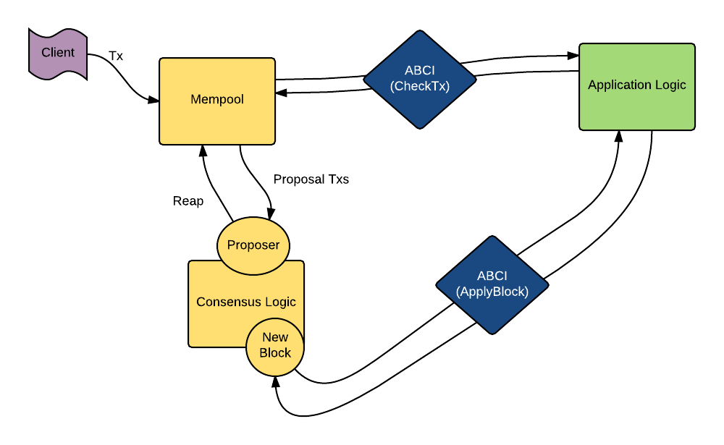
Basics
Tendermint Socket Protocol
Notes:
Explain the graphic
Run through a very simple example like the counter application

Slide 19
Questions & Break
Join at https://www.sli.do/ using #COSMOS
Notes:
Please take 3 minutes to write down any questions you might have about the COSMOS hub so that I can answer them later or submit them to sli.do

Slide 20
Scalability
IBC – Inter Blockchain Communication
Notes:
Need to implement two types of transaction: IBCBlockCommitTx and IBCPacketTx
IBCBlockCommitTx proves the most recent block hash
IBCPacketTx proves that a given packet was actually published
You send a token from blockchain1 and prove that it is actually locked up in the correct account

Slide 21
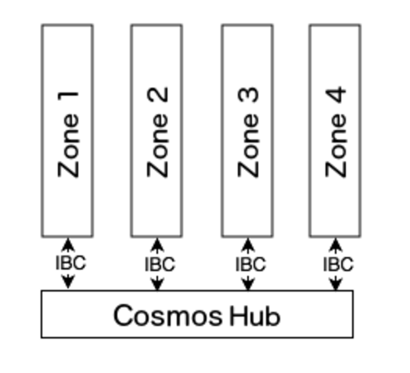
Scalability
Hubs
Notes:
Talk about staking
Preserves global invariance of the total amount of tokens across the zones
Security is paramount since a hub is a central ledger for the entire ecosystem
Zones can have lower security guarantees
Reference to geographically distributed zones
Hubs and zones form a directed acyclic graph
there can be multiple hubs

Slide 22
Scalability
Zones
Notes:
Zones cannot publish more tokens than they have
Zones can be source zones of tokens and create an infinite amount
The hub does not verify the state transition of zones, and users need to trust the zones they are interacting with

Slide 23
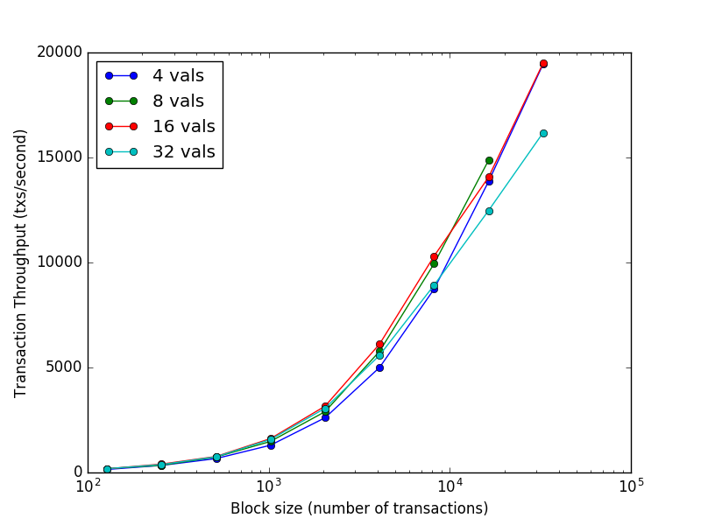
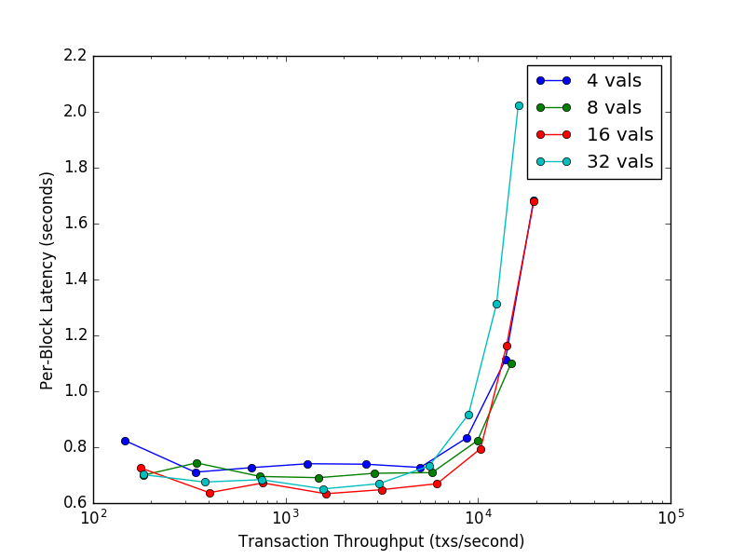
Scalability
Notes:
30,000 tx/s

Slide 24
Interoperability
Zones can contain arbitrary states and business logic
Notes:
Zones are fully independent and can have arbitrary state updates
Can be written in any language
Have to whitelist the tokens that they know how to handle
Can deal with multiple tokens from the ecosystem

Slide 25
Interoperability
Synchronisation through the hub or peer to peer
Notes:
Zones with high traffic can synchronise directly without the need for the hub
The network overhead of connecting all zones is immense though
The hub enforces global invariants and users will probably prefer to use a hub
There can be multiple hubs

Slide 26
Interoperability
Zones do not have to open source their business logic
Notes:
Zones can be completely closed source
Give an example of enterprise companies like Did connecting their own zone to the cosmos hub

Slide 27
COSMOS APPS
Ethermint
Notes:
20x implementation of the EVM based on PoS
Fully compatible with all go-ethereum tools

Slide 28
COSMOS APPS
Weave SDK
Notes:
Framework to build your own cryptocurrency
Has easy to use middleware that users can take advantage off

Slide 29
COSMOS APPS
The Hub
Notes:
Based on weave SDK

Slide 30
COSMOS APPS
Ethereum Peg Zone
Notes:
Explain the peg zone
COSMOS bridge contract on mainnet ethereum
Ethereum peg zone which runs a full ethereum client and tracks the state of ethereum
Ethereum peg zone is a source zone and then releases funds to the cosmos hub

Slide 31
COSMOS APPS
How to interact with COSMOS
Build on top of Ethermint using Solidity
Use our language SDKs for Go, Rust, Java, JavaScript or Python
Implement the TSP protocol yourself in the language of your choice

Slide 32
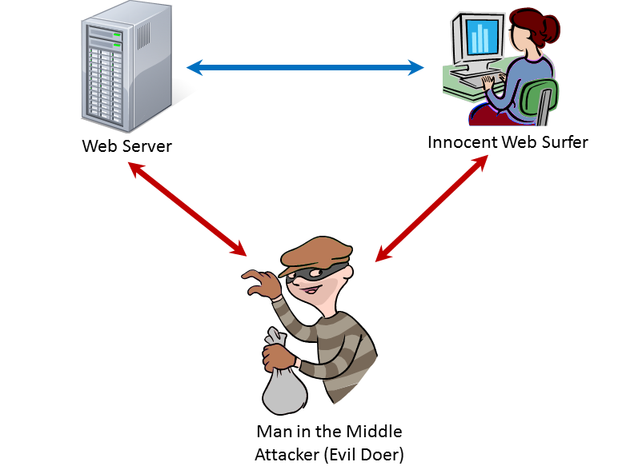
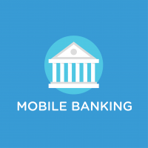
COSMOS APPS
Idea
Notes:
Decentralised exchanges
Mobile banking with light client
Machine learning

Slide 33
Questions
Join at https://www.sli.do/ using #COSMOS

Slide 34
NEXT STEPS
You are on the brink of discovery
Notes:
Thank everyone for listening
I hope that you learnt something
I hope that you take away one thing:
COSMOS is the natural next evolution of cryptocurrencies
It doesn’t try to outcompete anyone, but rather will bring all the silos closer together

Slide 35
NEXT STEPS
Future Roadmap
Production ready testnets in October
Live Network at the end of the year

Slide 36
NEXT STEPS
How to learn more
Developer Chats
Youtube Channel
Blogs
Developer updates via email
Meetups

Slide 37
NEXT STEPS
How to get in touch
WeChat Group
Rocket Chat
Email
Github Issues

Slide 38
NEXT STEPS
Upcoming Events
Meetups in Korea
CSEC in Berkley
Hackatom China
Devcon 3 in Mexico

Slide 39
Extra Resources
Tendermint/COSMOS Whitepaper
Tendermint in a Nutshell
Rocket Channel
Epicenter – Podcast
Core Developer Chat Livestreams - Youtube

Slide 40
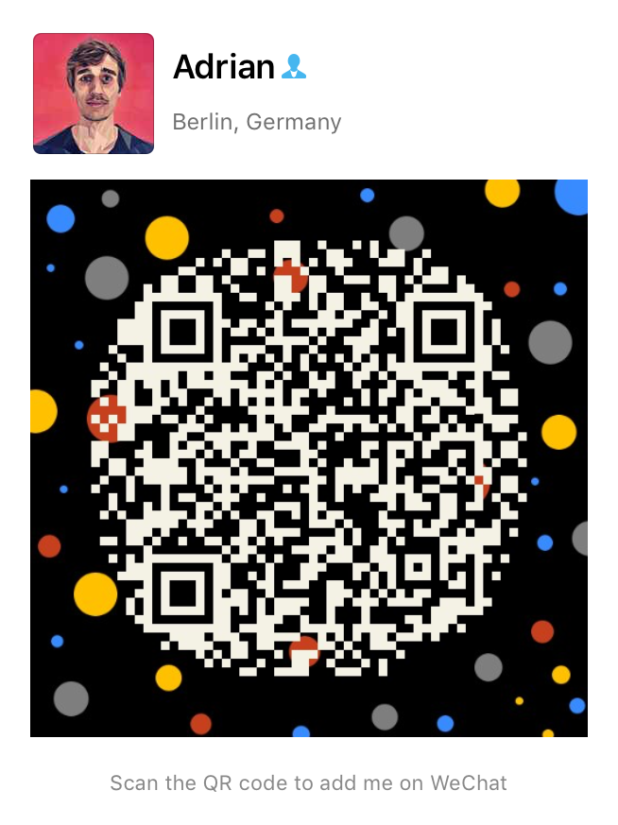
Where to find me?
Adrian Brink
WeChat: adrianbrink
Twitter: @adrian_brink
Github: adrianbrink
Telegram: adrianbrink
Email: adrian@tendermint.com|| adrian@brink-holdings.com
Research interest:
Consensus Engines
Secure peg zones
Decentralised Exchanges
E-voting
Usability

Slide 41
What is the COSMOS Hub?
Scalable Cryptocurrency
The COSMOS hub facilitates moving value across different zones and hub
Arbitrary business logic in the application layer
Instead of one to rule them all there will be multiple to work together
Notes:
The COSMOS hub will provide an interoperability layer between different blockchains
Zones such as Ethermint can register with the hub and then move value to the hub and potentially to other zones
Interoperability between blockchains
Example: Once we have a second zone for bitcoin you can seemlessly exchange bitcoins for ethereum on the Cosmos hub
Example: AirBnb tokens

Slide 42
What are we building?
Everything that is needed for the
COSMOS Hub
Tendermint Core Engine
COSMOS Apps
Tendermint Apps
ABCI Protocol
Peg Zones
Decentralised Exchange
Enterprise Solutions
IBC Protocol
Notes:
tendermint is the underlying core engine that implements consensus (PoS) and P2P
Explain the difference between COSMOS apps and Tendermint apps
The core powers both, the difference lies in where the validator set is running
On top of that we are building basecoin
The baselayer for the COSMOS hub
A multi-asset blockchain that stores how many tokens are in each connected zone
Ethermint is the first zone
Provides smart contracts
Provides an EVM
Secured by PoS
Much higher throughput and blocktimes, 20 times faster

Slide 43
Brief Overview of Tendermint
The Blockchain is secured by Tendermint consensus
Proof-of-Stake algorithm that uses security deposits
Application logic is abstracted away
Arbitrary business logic can be build on top of Tendermint
Standalone Tendermint application can become zones on the COSMOS hub
Notes:
- The network is secured by validators that either deposit money or are verified
Our version of PoS and how it secures the network
Building applications on top of Tendermint
How do zones work? Consensus Engines

Slide 44
Why Tendermint and what makes us different?
Tendermint Core implements a Proof-of-Stake consensus algorithm
Doesn’t waste electricity but rather uses security deposits
Secure and formally verified
Full specification on GitHub
Guarantees safety & liveness through the algorithm and a weak synchrony assumption
Is optimal Byzantine Fault Tolerant
Requires +1/3 byzantine failures to violate safety/liveness
Is fully fork accountable
We can figure out who tried to cheat and punish them
Much simpler than other implementations such as Casper (Ethereum)
Notes:
The entire code base is roughly 25,000 lines of go
It allows you to easily reason about it and verify the implementation
The consensus algorithm is only about 5,000 lines
Bitcoin is also vulnerable to the 1/3 attack

Slide 45

Properties and possible application
Fast and permanent block finality
Efficient light clients are available
The validator set is known and accountable
Regional zones
Notes:
A block is finalised every 1 second and once it is committed it will not change
In PoW chains you normally have to wait up to 12 confirmations before you can be certain that a block has been included
With Tendermint you are certain immediately
In PoW light-clients have to sync at least all the block headers
This means that there is usually a trusted server that provides an up-to-date view into the blockchain
Has all the usual problems of normal databases, it just sounds fancier since it is a blockchain
In Tendermint a light-client has to come online every 30 days and has to trust no server, it can fully verify the chain and the state
A great application can be mobile banking apps that are resistant against Man in the middle attacks
The validator set is known and accountable
With PoW most miners are anonymous and anyone can join the network
With Tendermint PoS the application determines who is allowed to validate blocks and each validator is identifiable

Slide 46
How to write your own business application?
The easiest way is to implement everything on top of Ethermint in solidity
We provide language bindings for Rust, Java, Go, JavaScript if you want to write your own persistent state machine
Implement a couple of required messages, such as Info() and DeliverTx()
Pitfalls:
Tendermint core opens three separate socket connections
Some events can run concurrently, whereas others require sequential execution
Speed is of essence essentially for apps that require larger application states
Light-clients have to be considered from the beginning
Notes:
You have three options
Either write them on top of ethermint as solidity smart contracts, Common Wealth Bank of Australia is doing that
Or write them on top of basecoin, which currently is mostlyl a cryptocurrency layer
Or write your own ABCI app

